Slide 1
In and Out
Linux 2 // Day 3
Cybersecurity Boot Camp |

Slide 2
Today’s Goals
By the end of class, you will be able to:
Explain the relationship between file descriptors and data stream
Use redirection to control stdin, stdout, and stderr
Perform the same task multiple times with for loops
Collect user input through script arguments
Notes:
But today, we’re going to… Review goals, address questions.

Slide 3
I/O Data Streams, File Descriptors and Redirection

Slide 4
I/O Data Streams
A data stream is a way to describe channels of data as they are processed and moved through a system.
Linux systems use data streams to move data from one process or program to another.
The three most used data streams are:
stdin – used to stream input data
stdout - used to stream output data
stderr - used to stream error data

Slide 5
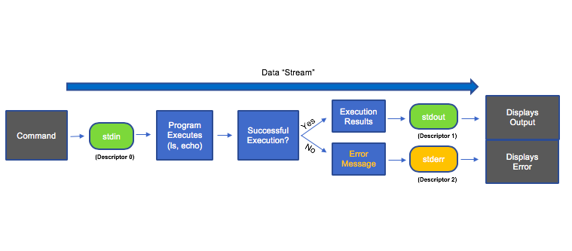
I/O Data Streams

Slide 6
I/O Data Streams. File descriptors and redirection
[Instructor Walk-thru]

Slide 7
Cat Whisperer (0:20)
In this activity, you will use the terminal to practice using stdin and stdout redirections with the cat command.
Instructions:
1. Start by returning to the same Virtual Machine.
2. Run the command cat < /etc/passwd.
What do you see?
How is this different from cat /etc/passwd?
Rewrite this command using the file descriptor for stdin.
3. Next, run: cat << EOF
After entering this command, you will get a prompt because the cat program is now waiting for your input.
Enter a few lines of text, hitting the return key each time.
After a few lines of text, type EOF and hit return. What happens?
Explain what you think EOF means.
Bonus
Now, run: cat << EOF > my_file.txt
How is this different from just cat << EOF
Describe in detail what will happen when you complete this command.

Slide 8
Throw Err to the Wind Demo
[Instructor Walk-thru]

Slide 9
file $(find . -iname *.txt 2> /dev/null) > ~/Desktop/text\ files ; tail -f ~/Desktop/text\ files
For loops metacharacters
$() for command expansion.
. to reference your current location.
* expands to any number of characters.
2> redirects stderr to /dev/null in order to hide errors.
> redirects stdout to a new file.
~ expands to the home path of the user.
\ escapes the space in the file name.
; runs the tail command while the find command is still running.

Slide 10
Today’s Goals
By the end of class, you will be able to:
✅ Explain the relationship between file descriptors and data stream
✅ Use redirection to control stdin, stdout, and stderr
Perform the same task multiple times with for loops
Collect user input through script arguments
Notes:
But today, we’re going to… Review goals, address questions.

Slide 11
for loops

Slide 12
for loops
Want to perform the same task within a script?
How about writing a script that does each task explicitly?
Copy and paste whole blocks of code?

Slide 13
for loops
Want to perform the same task within a script?
How about writing a script that does each task explicitly?
Copy and paste whole blocks of code?
Isn’t maintainable, doesn’t scale well, is error-prone

Slide 14
for loops
Want to perform the same task within a script?
How about writing a script that does each task explicitly?
Copy and paste whole blocks of code?
Isn’t maintainable, doesn’t scale well, is error-prone
for loops allow you to perform the same task multiple times without repeating a block of code

Slide 15
Syntax of for loops
for loops start with For VAR_NAME in LIST
The list can be a series of strings
Keywords do and done mark the beginning and end of the list
Everything in-between do and done gets run once for element of the list
Each time the code block runs, NAME gets changed to be the next name in the list:

Slide 16
First Steps with For
Open the script in first_for_unsolved.sh. Use the comments to guide you, and then follow the instructions below.
Instructions
1. Write a for loop that prints out the messages:
"Hello, Moe!"
"Hello, Larry!"
"Hello, Curly!"
2. Write a for loop that prints out the messages:
"I've used Mac OS X."
"I've used Windows."
"I've used Linux."
3. Run the provided for loop. What does the * character mean?
for FILE in *
do
echo "$FILE"
done
4. On your Terminal (not in the script), run: seq 1 10. What does this do?
5. Use seq and command expansion to print out the numbers between 1 and 24.

Slide 17
Review
Instructions
Command Expansion
The which <command> command prints the absolute path to <command>.
For example, which ls reports that the command ls is in the file /usr/bin/ls.
$ which ls /usr/bin/ls
The file <Target> command tells you what kind of file <Target> is. For example, file Notes.txt tells you that Notes.txt is a text file.
Use file and a command expansion to find out what kind of file cat is.
What does LS_PATH=$(which ls) do?
Note: Feel free to run this in your Terminal to find out! Try running echo $LS_PATH after setting the variable.
Redirection
Consider the command: cat nonexistent_file 2> /dev/null
What will print to the Terminal? Why?
Consider the command: cat nonexistent_file > /dev/null
What will print to the Terminal? Why?
Consider the command: cat /etc/passwd > /dev/null. Assume /etc/passwd exists!
What will print to the Terminal? Why?

Slide 18
Today’s Goals
By the end of class, you will be able to:
✅ Explain the relationship between file descriptors and data stream
✅ Use redirection to control stdin, stdout, and stderr
✅ Perform the same task multiple times with for loops
✅ Collect user input through script arguments
Notes:
But today, we’re going to… Review goals, address questions.

Slide 19
End

